Slide 1

The Catering Management System: SuperPOS
Screen button layout follows theme of Windows 8 (certain pages only, others like configuration pages use traditional layout)
Be able to run on Windows 7, Windows 8 & new Windows 10
Support multiple languages i.e. Thai, Traditional and Simplified languages display (food items display and print out only) and input
Screen adjustable to support 4:3 1024 x 768 and wide screen 16:9
Support external USB Caller ID display box, pop up window for takeaway delivery and collection
Support display of 10 miles radius or whole UK postcode, actual driving distance from Google API (Bing Map) or any other applications
Hot keys for Keyboard Operations (For taking takeaway orders only)
Networking method follows EXPOS
Strictly confidential – please do not re-distribute or disclose to third parties

Slide 2
The Catering Management System: SuperPOS
Files located at c:\program files\SuperPOS
Normally database file stores on USB drive F:\ but when unplugged it will fall back to c:\program files\SuperPOS
Strictly confidential – please do not re-distribute or disclose to third parties

Slide 3

Software
Upgrade
&
Licence
Milpo
Online
Takeaway
NetShop
Remote
Support
Logon to
SuperPOS
SuperPOS ePOS System Version 3.01 Copyright @ 2014 All Right Reserved Gwenwich (UK) Limited

Slide 4

Company logo
  This logo picture is a JPG file, located at c:\program files\SuperPOS
Software Upgrade and Licence
  Software Upgrade to provide a path to copy the exe file from USB drive to the program folder under c:\program files\SuperPOS
  Licence is to set the expiry date of the software, password is required to set this
Milpo Online Takeaway Netshop
  Direct to the hyperlink of customers’ online website page. E.g. http://www.abcrestaurant.co.uk)
Remote Support
  to run the Teamviewer quick support software
Logon to SuperPOS
  Go to the log on page of the SuperPOS software

Slide 5


Password
Date: 02/10/2012
Time: 11:05:38
A
1
2
3
Session: LUNCH
B
4
5
6
C
7
8
9
LOGON
EXIT
D
CLEAR
0
OK

Slide 6


Logo picture of Milpo Technologies
  This logo picture is a JPG file, located at c:\program files\SuperPOS
  The picture file size is fixed
Logo picture of customer
  This logo picture is a JPG file, located at c:\program files\SuperPOS
  The picture file size is fixed
Date time display window
  Show time, date and shift session, breakfast, lunch, dinner or supper
EXIT
  When pressed to EXIT the POS software, prompt ARE YOU SURE TO EXIT, and YES or NO to exit. A manager password is required to EXIT the software
EXIT

Slide 7
Control Panel
System Setting
System
Configuration
User
Maintenance
Data Manager
Compact
Database
Computer
Address
Shift Code
Takeaway & Quick Dining Setting
Takeaway
Configuration
Menu Category
Menu Item
Manage
Menu Set
Extra Menu
Edit
Order Control
Department
Code
Table Setup
Print Setup
Caller
Record
Eat In Setting
Eat-In
Configuration
Menu Category
Menu Item
Manage
Menu Set
Extra Menu
Edit
Order Control
Department
Code
Table Setup
Printer
Order Entry
Print Setup
Reporting
Account
Summary
Reports
System
Control
Exit

Slide 8
System
Control
System Control
  For Milpo technical staff use only
  Only Milpo Admin Supervisor password can see the System Control button
  Other users can not see this System Control button
  It is for some hidden system settings
Takeaway & Quick Dining Setting
  Set the parameters for Takeaway and Quick Dining only
Eat In Setting
  Set the parameters for Eat In only
Reporting
  View sales summary and reports generations

Slide 9
System Configuration
Shop Details
Caller ID Port Setting
Shop Name
Jade Garden Restaurant
Device #1
Address :
188 London Road
Colchester CO2 8 AB
Device #2
General Setting
Cash Drawer Setting
Display Item Code Select
Use Cash Drawer
Input Number of Persons
Back Up When Exit
Cash Drawer Password
Back Up Drive
E
Till Number
1
Keypad Setting
Default Order Input Page
1
Currency
£
Key 1
S
Key 6
D
VAT Percentage
20.00
Key 2
B
Key 7
E
Print Options
Key 3
G
Key 8
M
Key 4
Y
Key 9
K
Save
Report Printer
INV
A4 Report Printer
Canon
Key 5
Z
Key 10
Y
Round Up Decimal
2
Exit

Slide 10

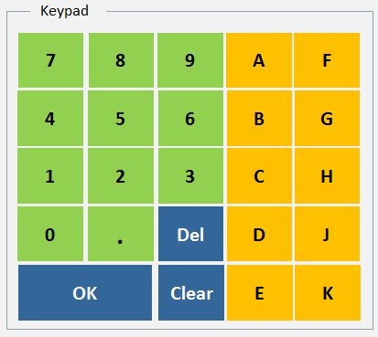
Display Item Code Select
  The dish number (code) is displayed next to the dish name (“[12] Chicken Curry”)
Setting Input Number of Persons
  If this is enabled. Whenever a new table is open, it will pop up a new window asking the user to key in the number of persons
  If disabled, no window will pop up and the default number of person will be 1
Backup When Exit
  When the user exits the SuperPOS software, it will save a copy of database file on a specified location
Backup Drive
  Specify the location to back up the database file when exit
Till Number
  Till number is the ID of a POS terminal, e.g. 1, 2, or B1...
Default Order Input Page
  It tells the software what page to display when the POS software is started
  It be either be Takeaway, Eat In or Quick Food
Currency
  Can be either £, $ or Euro
VAT Percentage
  Current value is 20%, use to calculate the value added tax amount
Report Printer
  Define printer to print till rolls 80 mm simple reports
A4 Printer
  Define printer to print A4 size reports
Round Up Decimal
  Define whether to use 四寫五入, round up to two decimals
Cash Drawer
  Define whether to use cash drawer
Keypad Setting
  Define characters of keypad

Slide 11
User Maintenance
Save
Exit
User Name
Richard Lee
New User
Delete User
Password
Takeaway Access
QD Access
Eat In Access
General Access
Takeaway Access
Control Panel
Change Price
Price Off
Show Order / Print Acct Summary
Show Order / Change Payment
Show Order / Edit Order
Show Order / Print Receipt
Customer List / Export Data

Slide 12
User Maintenance
Save
Exit
User Name
Richard Lee
New User
Delete User
Password
Takeaway Access
QD Access
Eat In Access
General Access
Quick Dining Access
Control Panel
Change Price
Price Off
Show Order / Print Acct Summary
Show Order / Change Payment
Show Order / Edit Order
Show Order / Print Receipt

Slide 13
User Maintenance
Save
Exit
User Name
Richard Lee
New User
Delete User
Password
Takeaway Access
QD Access
Eat In Access
General Access
Eat-In Access
Control Panel
Change Price
Price Off
Pay
Print Bill
Remove Item After Printed
Table Booking
Show Order / Print Acct Summary
Show Order / Change Payment
Show Order / Edit Order
Show Order / Print Receipt
Print Bill / Discount

Slide 14
User Maintenance
Save
Exit
User Name
Richard Lee
New User
Delete User
Password
Takeaway Access
QD Access
Eat In Access
General Access
General Access
System Setting / System Config.
System Setting / Computer Add.
System Setting / User Maintenance
System Setting / Shift Code
System Setting / Data Manager
Takeaway Configuration
System Setting / Compact Database
Eat-In Configuration
Reporting / Reports
Takeaway / Print Setup
Reporting / Account Summary
Eat-In / Print Setup
Account Summary / Summary View
Account Summary / Print Sales Rpt
Logon screen EXIT POS software
Open Cash Drawer
Write & Enable Inventory

Slide 15
This page is to define the access level of each of the users
Takeaway Access
  Defines the pages or buttons that this user can access. If the user has no access right, the button will be grey
Quick Dining Access
  Defines the pages or buttons that this user can access. If the user has no access right, the button will be grey
Eat In Access
  Defines the pages or buttons that this user can access. If the user has no access right, the button will be grey
General Access
  Defines the pages or buttons that this user can access. If the user has no access right, the button will be grey

Slide 16
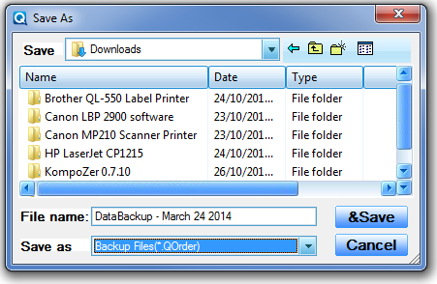
Data Manager
Data Manager
Backup Data
Restore Data
Exit

Slide 17
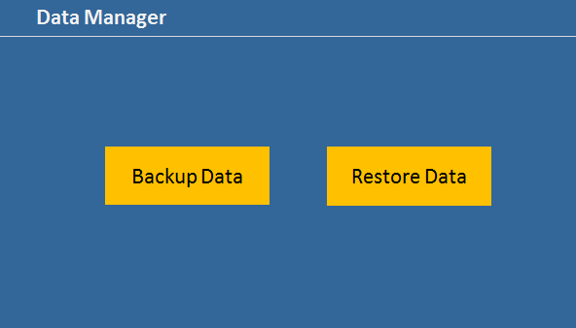
Data Manager
Restore Data
Are you sure you want to Restore Data? This can overwrite your existing data
Yes
No
Exit

Slide 18
Compact Database
Compact Database
Are you sure to compact the database file?
Yes
No
Exit

Slide 19
Computer Address Entry
Address Entry
Code
001
Computer Name
POS1
Add
Edit
Delete
Cancel
Save
Exit

Slide 20
Define the ID of this computer terminal so that this computer can be identified within the network
Addition of computer terminal
  If a new computer terminal is added to the network, the system will check the computer name and an ID code will be assigned to this new computer

Slide 21
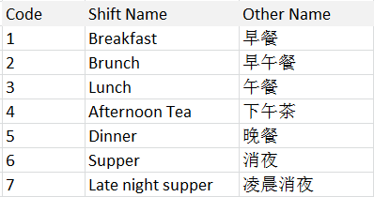
Shift Code Entry
Shift Code List
Shift Code Content Input
Shift Code
1
Shift Name
Special Price
Lunch
Other Name
Enable
午餐
From To
Sunday
12:00
15:00
Monday
OK
Tuesday
Wednesday
Thursday
Friday
Saturday
Add
New
Copy
Delete
Save
Exit

Slide 22
Define shift according to time slots
Shift name
  Different time slots will be assigned a shift name. e.g. 12:00 – 14:59 pm is called Lunch. 15:00 – 23:59 is Dinner time
Special Price
  Special prices can be applied to different shifts
  Say special prices are applied on Sunday Lunch or Special prices on Monday Afternoon Tea
  Special prices of each particular dishes will be picked

Slide 23
System Control
Function Access Control
Shop Details
Takeaway
Shop Name
Jade Garden Restaurant
Eat In
Address
188 London Road, Colchester CO2 8 AB
Quick Food
Shop Details Read Only
Smart Control
不入账
CTRL
F1
Access Code
038271625364599
Save
Exit

Slide 24
Define what pages the user can access
Access to the System Control page. Only Milpo super technical staff can access the System Control page
Fill in the name and address of the shop.
If Shop Details Read Only is enabled, user can not change the details in the System Setting. Only Milpo can change the shop details
Function Access Control
  Milpo defines what pages the restaurant user can access
Shop Details
  If the shop details is ticked as Read Only. Restaurant user can not change the shop details

Slide 25
END
(Slides beyond this page are for references only)

